Slide 1


DEPARTMENT OF ELECTRONICS AND COMMUNICATION ENGINEERING
PREDICTING HOUSE PRICES USING MACHINE LEARNING
TEAM MEMBERS :
KEERTHIKA .M(113321106042)
DEVIKA.S(113321106018)
FARZANA BEGUM.A(113321106025)
JASMIN IRFANA.Z(113321106036)
GAJALAKSHMI.A(113321106027)

Slide 2
PROBLEM STATEMENT :PREDICTING HOUSE PRICES USING MACHINE LEARNING
PROBELEM DEFINITION :
The housing market is an important and complex sector that impacts people's lives in many ways. For many individuals and families, buying a house is one of the biggest investments they will make in their lifetime. Therefore, it is essential to accurately predict the prices of houses so that buyers and sellers can make informed decisions. This project aims to use machine learning techniques to predict house prices based on various features such as location, square footage, number of bedrooms and bathrooms, and other relevant factors.

Slide 3
INTRODUCTION:
The real estate market is a dynamic and critical sector of the global economy, with housing being one of the most significant investments individuals make in their lifetime. Whether you are a prospective homebuyer, a real estate investor, or a homeowner looking to estimate the value of your property, predicting house prices accurately is of paramount importance. Fortunately, with the advent of machine learning and data science, we now have powerful tools and techniques at our disposal to make informed predictions about housing prices.

Slide 4
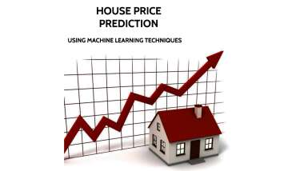
OBJECTIVES
The primary objective of this project is to leverage machine learning to predict house prices accurately. This endeavor serves multiple purposes:
1. Informed Decision-Making: For prospective homebuyers, understanding the factors that influence house prices can be invaluable. By building predictive models, we aim to provide insights into how various features, such as location, size, amenities, and market trends, affect property values. This information empowers buyers to make more informed decisions and negotiate better deals.
2. Real Estate Investment: Investors in the real estate market are constantly seeking opportunities to maximize returns. Predicting house prices can help identify potentially lucrative investments. By analyzing historical data and market trends, we intend to develop models that can guide investors in selecting properties that align with their financial goals.

Slide 5
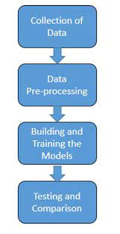
DATA SELECTION
:*Selecting an appropriate data source is a crucial step in predicting house prices using machine learning. You can obtain housing data from various sources, including:
1.Real Estate Websites: Websites like Zillow, Realtor.com, and Redfin often provide extensive datasets on property listings, including information on price, location, size, features, and historical sales data
2. Government Databases: Many government agencies maintain databases of property transactions, assessments, and tax records. These can be valuable sources of historical data
3.Open Data Portals: Some cities and regions provide open access to property data, which can be used for analysis and prediction.
4. Kaggle and Other Data Science Competitions: Platforms like Kaggle often host machine learning competitions related to house price prediction. You can use the datasets provided for these competitions.
5. Web Scraping: If necessary, you can use web scraping techniques to gather data from real estate websites or other online sources.

Slide 6
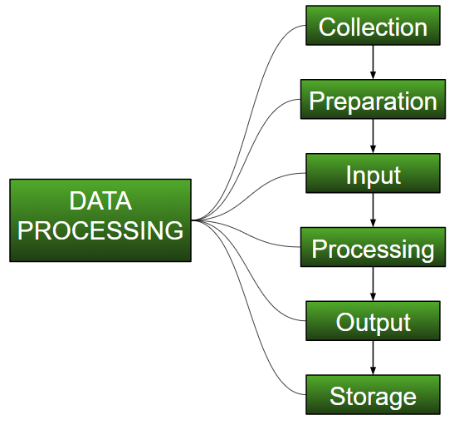
DATA PROCESSING
Once you have collected your data, you'll need to preprocess it to prepare it for machine learning. This involves several steps:
1. Data Cleaning: Identify and handle missing values, outliers, and inconsistencies in the data. This might involve imputing missing values, removing outliers, and correcting
2.Feature Selection: Analyze the importance of each feature in predicting house prices. You may need to eliminate less relevant features or perform feature engineering to create new meaningful features.
3.Data Transformation: Convert categorical variables into numerical representations using techniques like one-hot encoding or label encoding. Scale numerical features to have consistent ranges (e.g., using Min-Max scaling or Standardization).
4. Splitting the Data: Divide the dataset into training, validation, and test sets. The training set is used to train your machine learning models, the validation set helps in hyperparameter tuning and model selection, and the test set is used to evaluate the final model's performance.

Slide 7
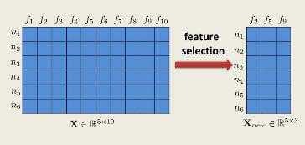
FEATURE SELECTION
Feature selection is a critical step in predicting house prices using machine learning. It involves choosing the most relevant and informative features (attributes) from your dataset to improve the accuracy and efficiency of your predictive model. Here are some methods and considerations for feature selection:
1. Univariate Feature Selection: - Statistical Tests:* You can use statistical tests like chi-squared, ANOVA, or mutual information to evaluate the statistical significance of each feature in relation to the target variable. - SelectKBest: Scikit-learn provides the `SelectKBest` method, which allows you to select the top k features based on a scoring function.
2. Recursive Feature Elimination (RFE): - RFE is an iterative method that starts with all features and gradually removes the least important ones based on the model's performance. This is often used with models that provide feature importance scores, like decision trees.
3. Feature Importance from Tree-Based Models: - Algorithms like Random Forests and Gradient Boosting Machines can measure feature importance. Features that contribute more to reducing impurity or error are considered more important.

Slide 8
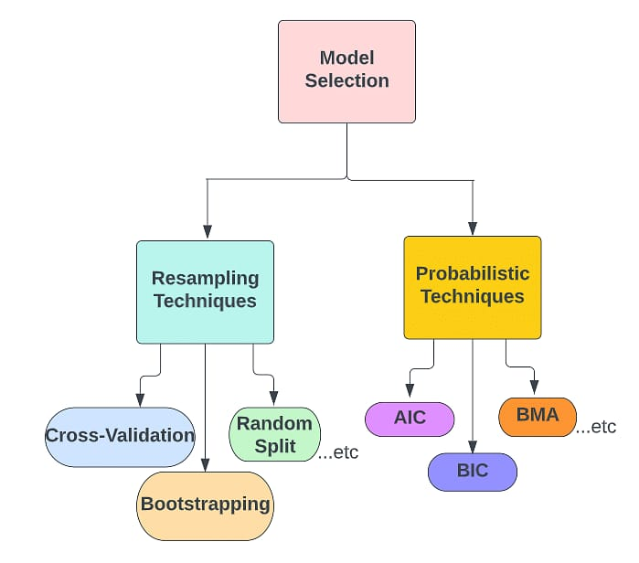
MODEL SELECTION
1. Linear Regression: A classic choice for regression tasks, linear regression models the relationship between features and house prices linearly. It's simple and interpretable but assumes a linear relationship.
2. Decision Trees: Decision tree models capture non-linear relationships and interactions between features. They are interpretable and can handle both numerical and categorical data.
3. Random Forests: An ensemble of decision trees, random forests improve predictive accuracy and reduce overfitting. They excel at handling complex datasets with many features.

Slide 9
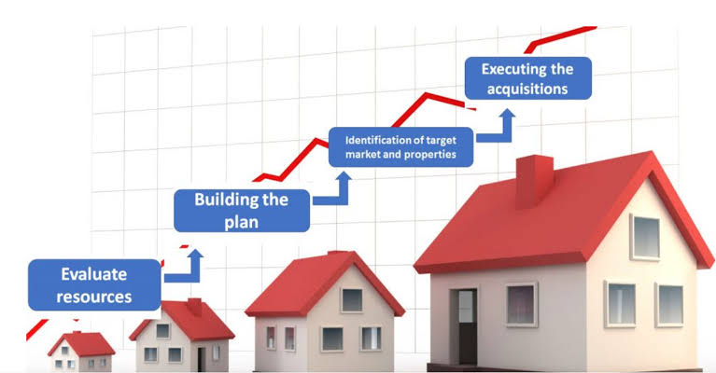
EVALUATION When predicting house prices using machine learning models, it's crucial to assess their performance accurately. Here are key evaluation aspects: 1. Evaluation Metrics: Choose appropriate metrics based on your problem: - Mean Absolute Error (MAE): Measures the average absolute difference between predicted and actual prices. Easy to interpret. - Mean Squared Error (MSE): Squares the errors, giving more weight to larger errors. Common but sensitive to outliers. - Root Mean Squared Error (RMSE): The square root of MSE, which is in the same unit as the target variable. - R-squared (R2): Measures the proportion of variance in the target variable explained by the model. Higher values indicate better fit. 2. Cross-Validation:Use techniques like k-fold cross-validation to assess how well the model generalizes to unseen data. It helps detect overfitting and provides more robust performance estimates.

Slide 10
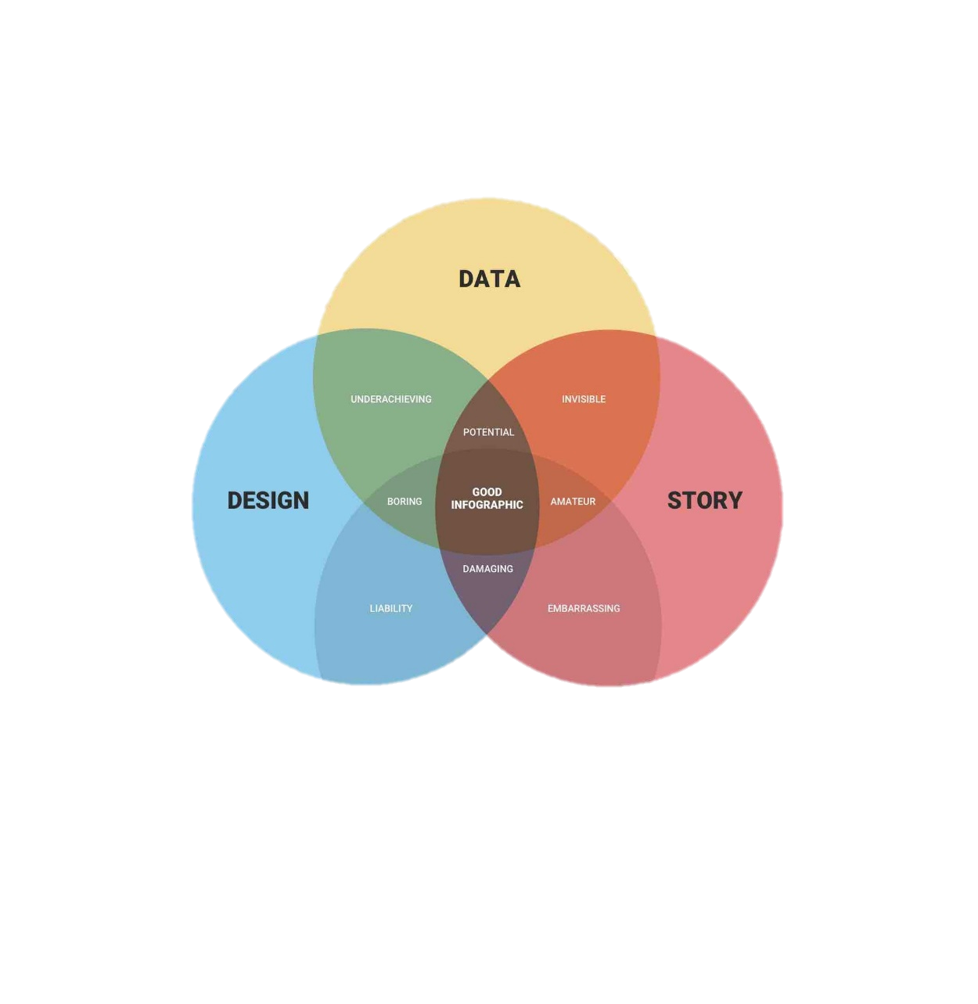
DATA VISUALIZATION
Data visualization is crucial when working on predicting house prices using machine learning. It helps you understand the data, identify patterns, and communicate your findings effectively.Data visualization is the representation of data through use of common graphics, such as charts, plots, infographics, and even animations.
Histograms: Create histograms to visualize the distribution of house prices, which can help you understand their range and distribution
Scatter Plots: Plot features like square footage or number of bedrooms against house prices to see how they correlate. Scatter plots can reveal linear or non-linear relationships.
3. Heatmaps: Use heatmaps to visualize the correlation matrix of features. This shows which features are most correlated with house prices, helping in feature selection.
Geospatial Maps: If you have location data, create maps to visualize house prices across different areas. This can be done using tools like Geographic Information Systems (GIS).
Line Charts: If you have time-series data or want to show how house prices change over time, use line charts to display these trends.It can be useful for visualizing categorical variables like property types or neighborhoods and their impact on prices.

Slide 11
CHALLENGES AND LIMITATIONS
Challenges:
Data Quality: The accuracy of predictions heavily depends on the quality and quantity of data available. Inaccurate or incomplete data can lead to poor predictions.
Feature Selection: Choosing the right features (e.g., square footage, location, number of bedrooms) is crucial. Selecting irrelevant or redundant features can result in overfitting or underfitting.
Non-linearity: Housing prices often exhibit non-linear relationships with features. Simple linear models may not capture these complexities effectively
Outliers: Extreme data points, such as unusually expensive or cheap properties, can skew predictions. Proper outlier handling is essential.
Limitations:
Economic Factors: Machine learning models often do not consider macroeconomic factors like inflation, interest rates, or housing market trends, which can significantly impact house prices.
Housing Market Psychology: Human behavior, emotions, and market sentiment play a role in pricing but are challenging to quantify accurately.
Dynamic Nature: Housing markets change over time, and models may become outdated quickly if not regularly retrained with fresh data.
Privacy Concerns: Access to detailed housing data, including personal information, raises privacy and ethical concerns.

Slide 12

CASE STUDY
Redfin's Home Value Estimate:
Company: Redfin, a real estate brokerage company in the United States.
Case Study: Redfin offers a Home Value Estimate tool that predicts the value of properties. They use a combination of public and proprietary data, including MLS data and information from their platform, to make these predictions. It is a well-known example of using machine learning to predict house prices. They employ a variety of data sources, including property details, historical sales data, and local market trends, to estimate property values.
Machine Learning Techniques: Redfin employs various machine learning models and algorithms to improve the accuracy of their predictions. It also uses a combination of regression models, neural networks, and other techniques to refine their estimates. Participants in these competitions use various regression algorithms, feature engineering, and ensemble methods to improve predictive accuracy.
Outcome: The Home Value Estimate tool is used by homeowners, buyers, and sellers to assess property values. Redfin continually refines its models to provide more accurate estimates. This showcases the diversity of approaches and techniques that data scientists can employ to predict house prices effectively. Winning solutions often combine domain expertise with advanced machine learning methods.

Slide 13
FUTURE ENHANCEMENT
AI Explainability: Developing techniques to make machine learning models more interpretable and explainable will be crucial for gaining trust and understanding in the predictions.
Geospatial Analysis: Utilizing geospatial data and GIS (Geographic Information Systems) can provide more accurate location-based insights, considering factors like traffic patterns, school districts, and crime rates.
Transfer Learning: Applying transfer learning from related domains, such as urban planning or economics, can improve model generalization and adaptability.
Ethical and Fair AI: Ensuring that predictive models are trained and deployed in a fair and ethical manner to avoid perpetuating biases and discriminatory practices.
User-Friendly Interfaces: Developing user-friendly applications and interfaces that allow homeowners, buyers, and sellers to interact with predictive models easily

Slide 14
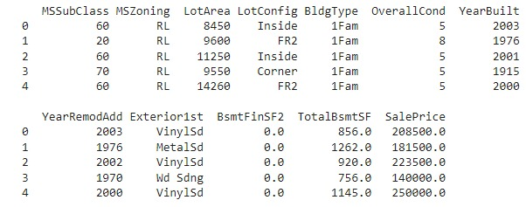
CODE
import pandas as pd import matplotlib.pyplot as plt import seaborn as sns dataset = pd.read_excel("HousePricePrediction.xlsx") # Printing first 5 records of the dataset print(dataset.head(5))
OUTPUT

Slide 15
ANALYSIS
Data Collection: - Gather a dataset that includes information about houses and their sale prices. Common features include square footage, number of bedrooms, location, year built, etc.
Data Preprocessing: - Handle missing data and outliers. - Convert categorical variables (like location) into numerical format using techniques like one-hot encoding. - Normalize or scale numerical features to bring them to a similar range.
Data Split: - Split your dataset into a training set and a testing set. This helps in evaluating the model's performance.
Model Selection: - Choose a regression algorithm. Common choices include Linear Regression, Decision Trees, Random Forests, Support Vector Machines, or Neural Networks.
Feature Selection/Engineering: - Identify the most relevant features for predicting house prices. - Create new features if they might be more informative (e.g., a 'price per square foot' feature).
Model Training: - Train the selected model on the training data. The model learns to map the features to house prices.

Slide 16
7. Model Evaluation: - Use evaluation metrics like Mean Absolute Error (MAE), Mean Squared Error (MSE), or Root Mean Squared Error (RMSE) to assess the model's performance on the test data.
8. Hyperparameter Tuning: - Fine-tune the model's hyperparameters to improve its performance.
9. Cross-Validation (Optional): - Implement cross-validation to get a more robust estimate of the model's performance.
10. Deployment: - Once satisfied with the model's performance, deploy it in a real-world setting to predict house prices.
11. Monitoring and Maintenance: - Continuously monitor the model's performance and retrain it periodically with new data to ensure its accuracy over time.
12. Interpretability: - Depending on the model used, you may want to interpret its predictions. Techniques like feature importance can help understand which features most influence house prices.
Remember, the choice of features, the model, and the evaluation metrics can vary based on your specific dataset and problem. Regular updates and maintenance of the model are essential to keep it accurate as real estate markets change over time.

Slide 17
THANK YOU

